Slide 1



Short Term Load Forecasting Tool
Dr. Naveed Arshad
Associate Professor, Energy Informatics Group, LUMS

Slide 2
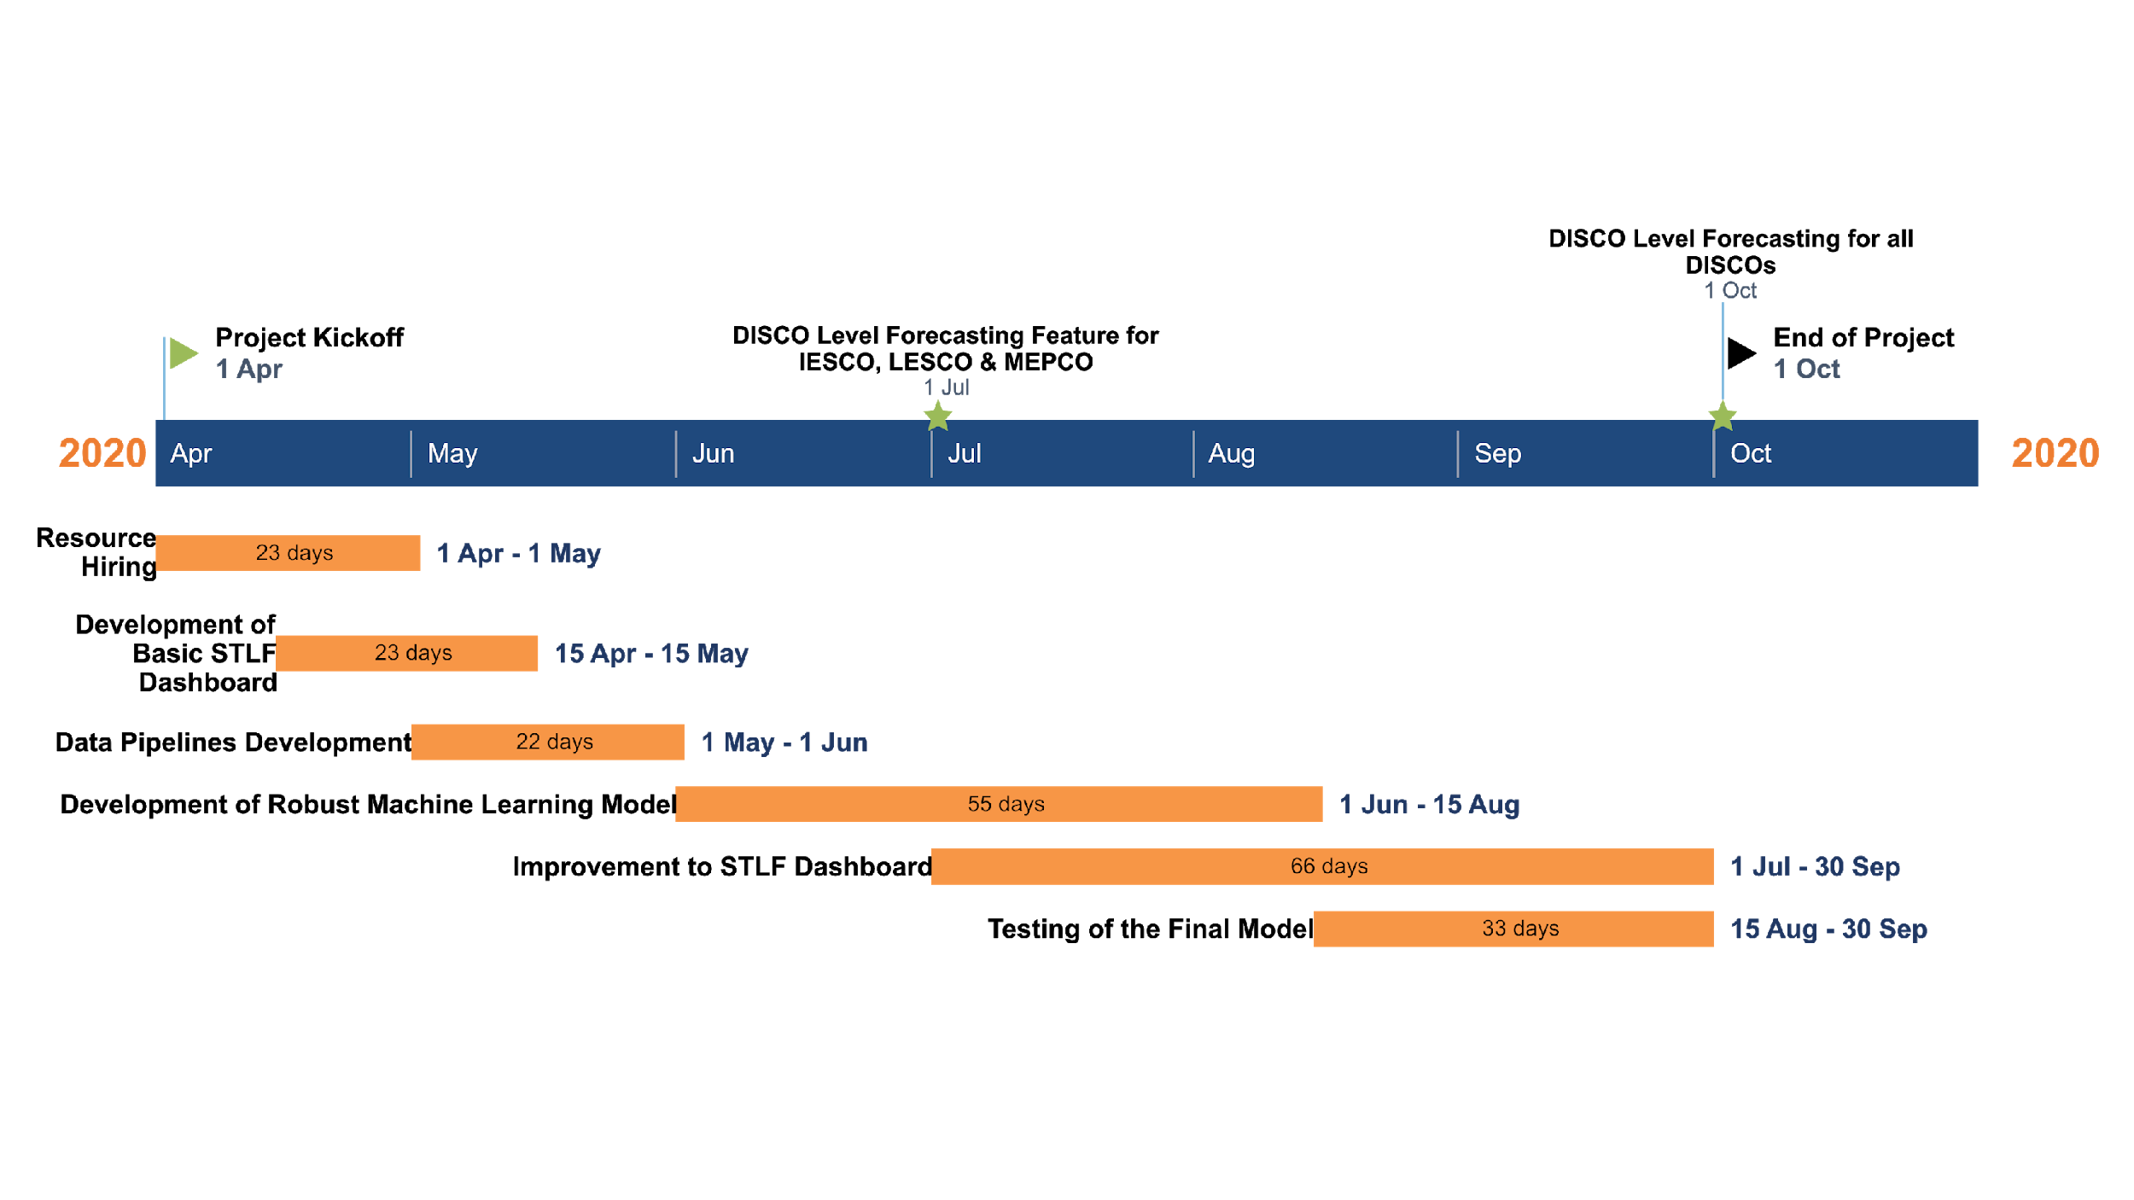
Project Timeline

Slide 3
Forecasting Attributes
Historical Load
Daily Lag
Weekly Lag
Yearly Lag
Apparent Temperature (Combination of Temperature & Humidity)
Seasonality (Summer, Winter, Spring, Autumn)
Day of the Week Label
Public Holidays
Special Events (Religious, Cultural & Political)
Power Grid Faults & Events
Note: Currently First Two are Implemented

Slide 4
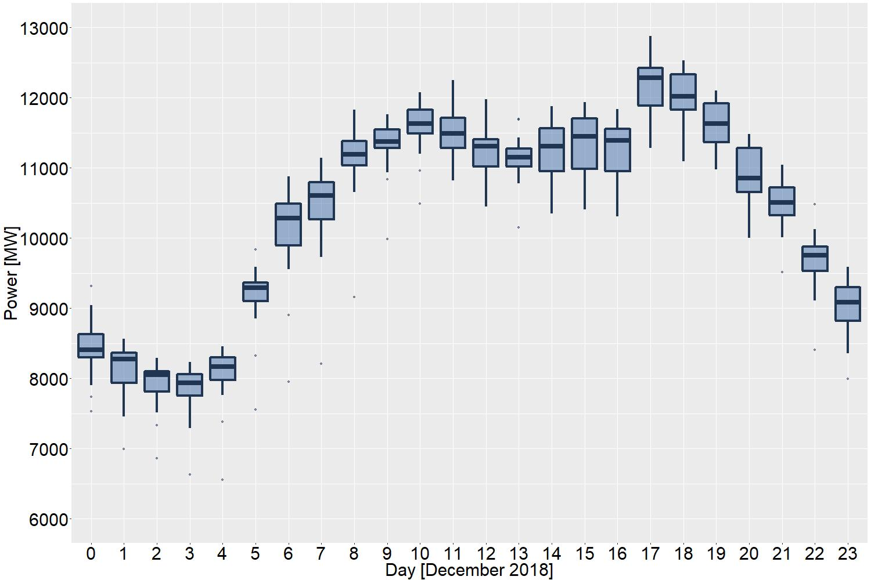
Daily Load Patterns
Hour of the Day

Slide 5
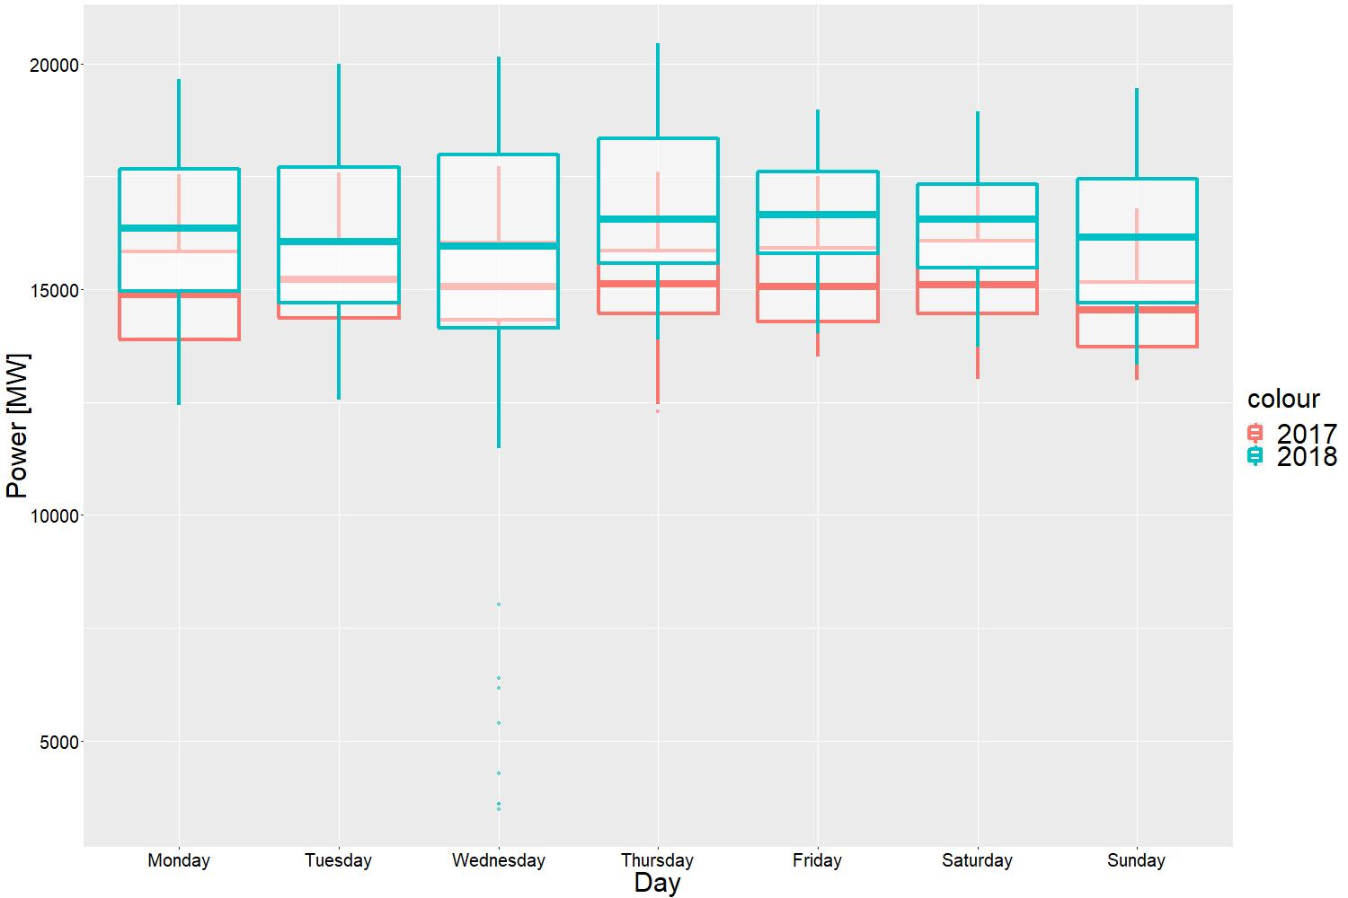
Weekly

Slide 6
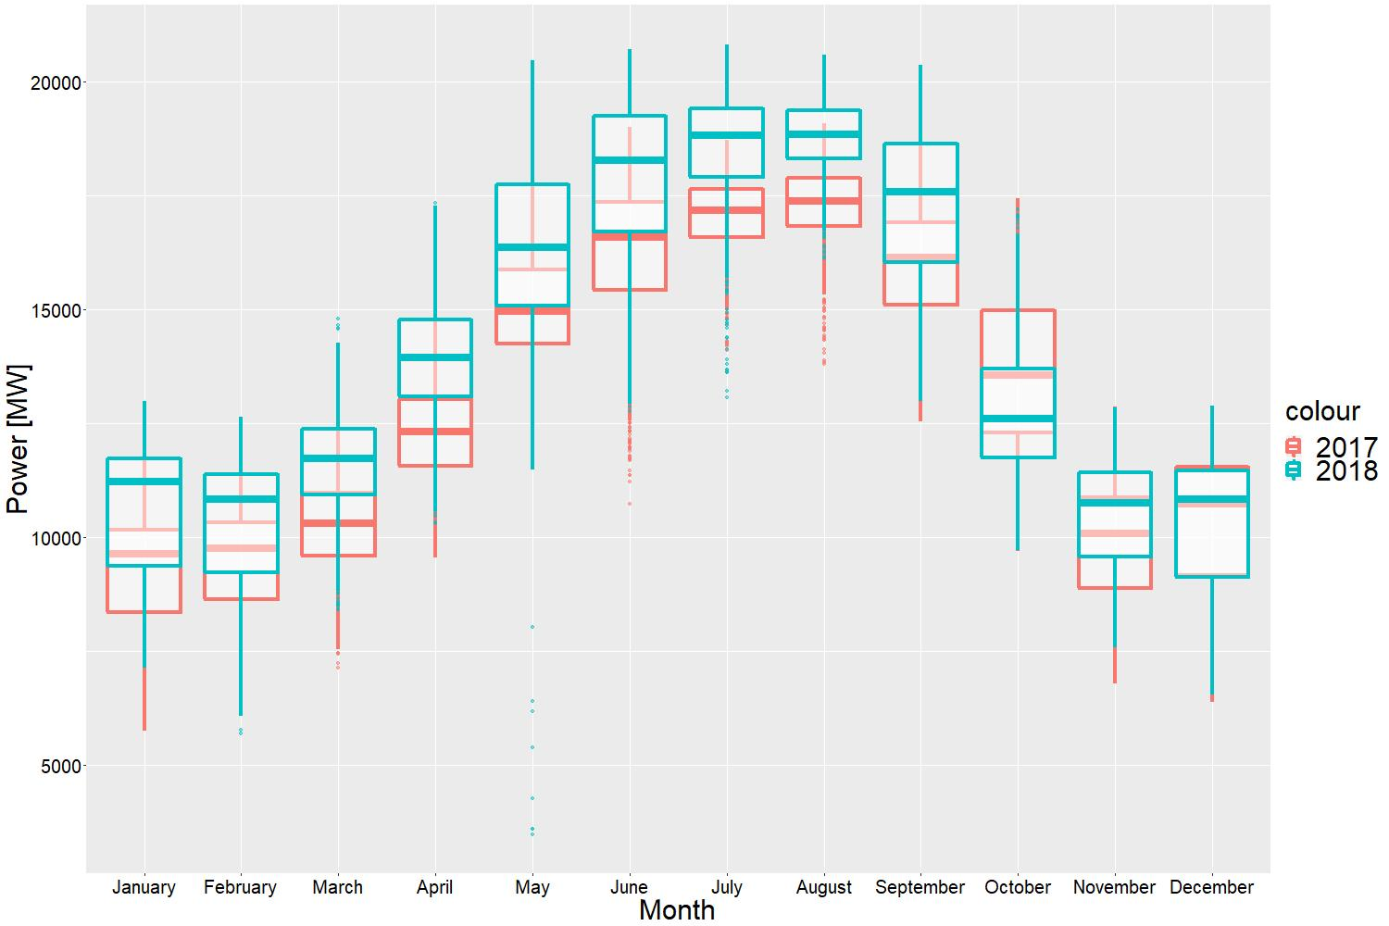
2017 vs 2018

Slide 7
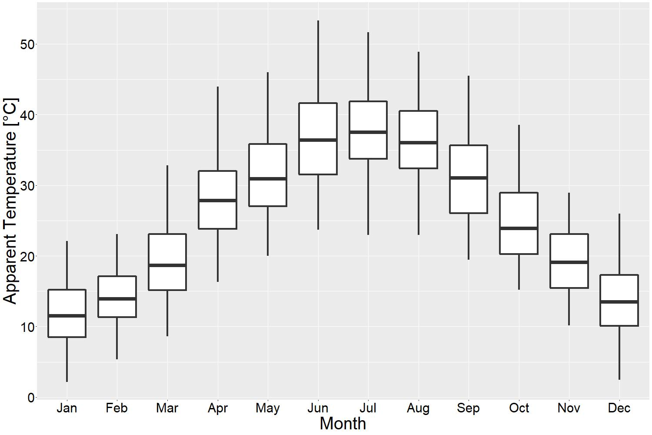
Apparent Temperature

Slide 8
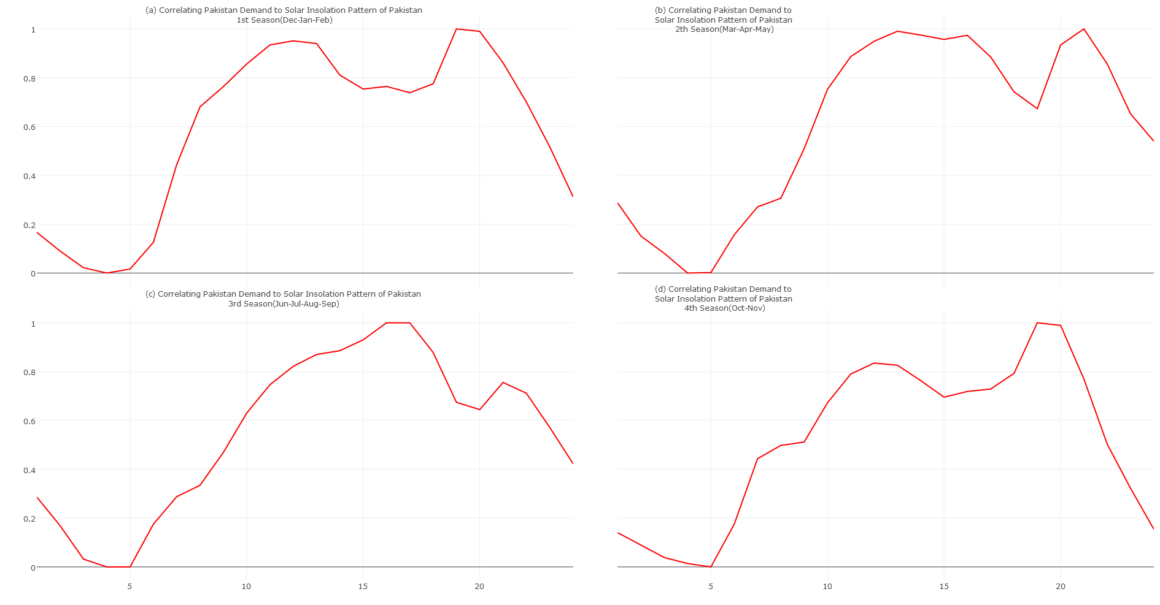
Seasons (Not used Right now)
Dec-Feb
Mar-May
Jun-Sep
Oct-Nov

Slide 9
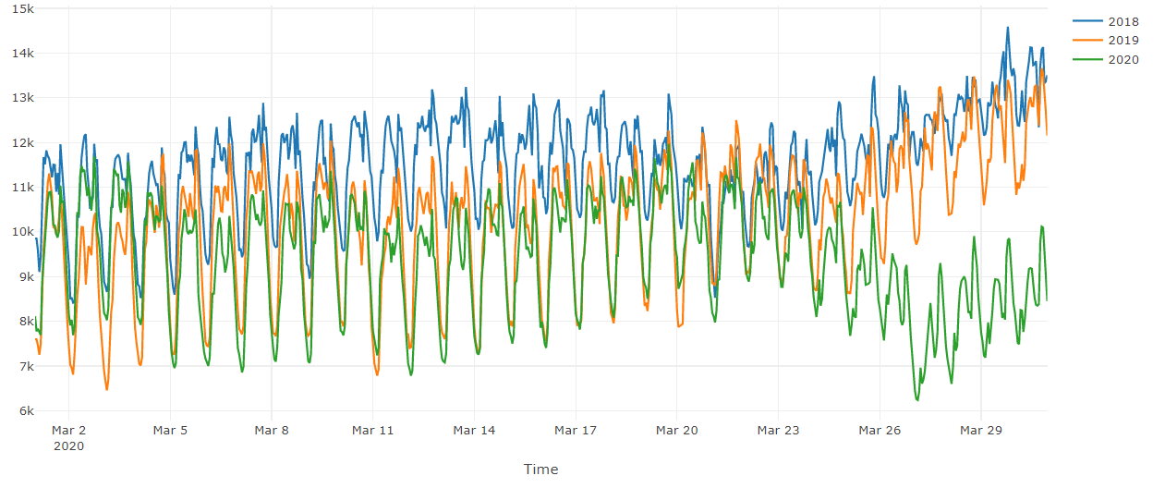
Yearly Load Comparison COVID-19 Disruptions

Slide 10
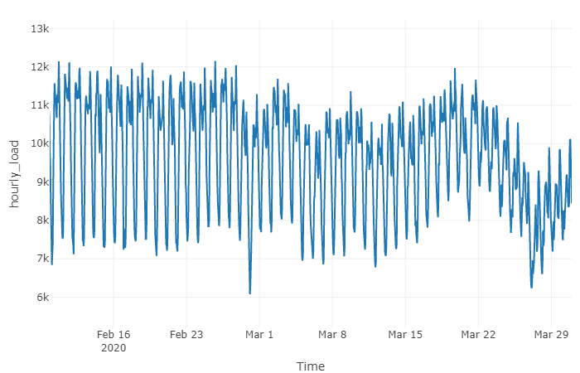
COVID-19 Disruptions
First Case of Corona in Pakistan Reported
Pakistan claim risk of COVID-19 Outbreak
Pakistan Govt. Announces Lockdown
Rainy Day across Pakistan
Sindh Govt. Impose Semi-Lockdown

Slide 11
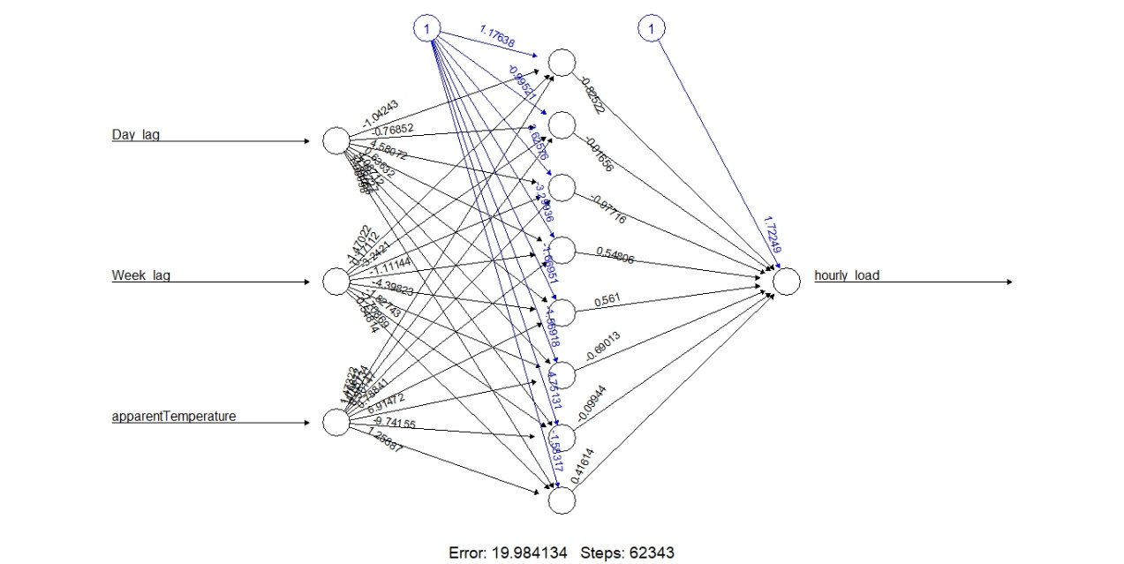
Artificial Neural Networks
ANNs are machine learning algorithms that have hidden layers and weights, modeled after a human brain.
The network learns weights using training dataset.
This can be used for both classification and regression
The algorithm can be used to learn time series data (Demand Profile by NPCC) and get forecast for the future days.

